Slide 2
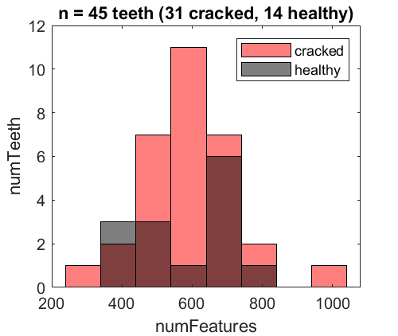
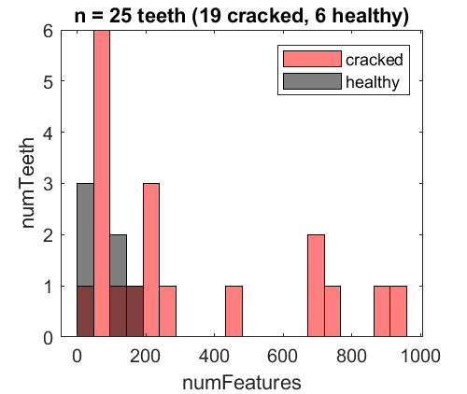
a
Micro-CT
b
Hr-CBCT

Slide 3
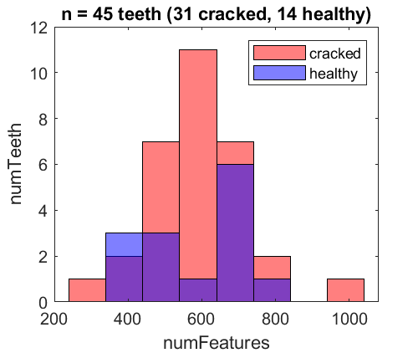
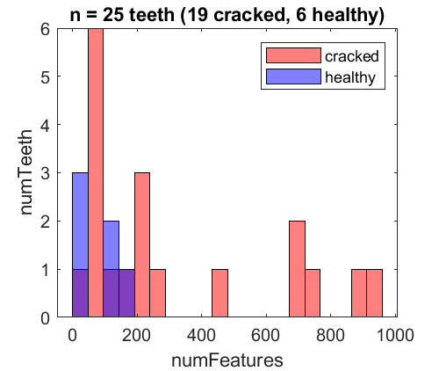
a
Micro-CT
b
Hr-CBCT
Number of Teeth
Number of Teeth
Number of Cracks per Tooth
Number of Cracks per Tooth

Slide 4
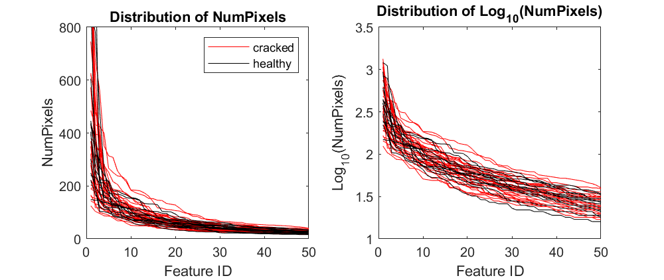
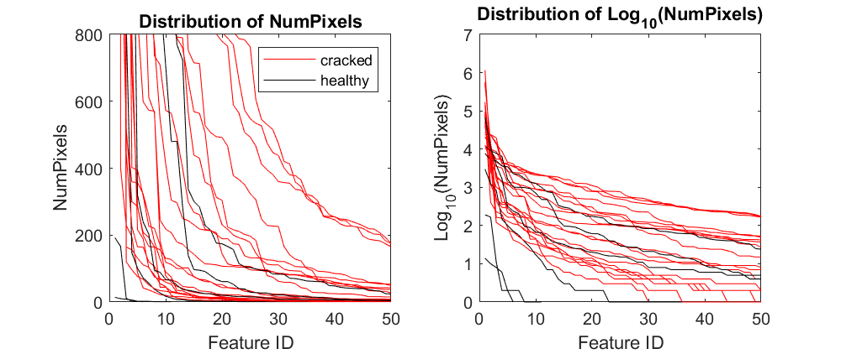
a
MicroCT
b
Hr-CBCT
Distribution of NumVoxels
Distribution of NumVoxels
NumVoxels
NumVoxels
Distribution of Log₁₀(NumVoxels)
Distribution of Log₁₀(NumVoxels)
Distribution of log10(NumVoxels)
Log₁₀(NumVoxels)
Log₁₀(NumVoxels)

Slide 5
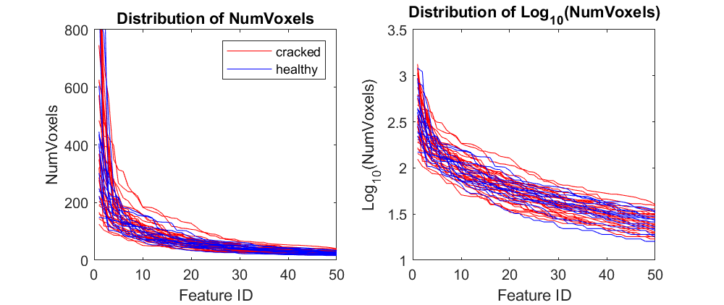
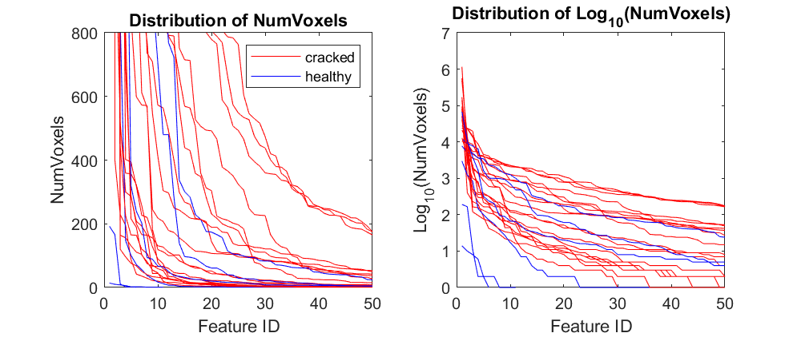
a
Micro-CT
b
Hr-CBCT
Crack Size Curves
Crack Size Curves
Crack Size
Crack Size
Crack ID
Crack ID
Log₁₀(Crack Size) Curves
Log₁₀(Crack Size) Curves
Log₁₀(Crack Size)
Log₁₀(Crack Size)
Crack ID
Crack ID

Slide 6
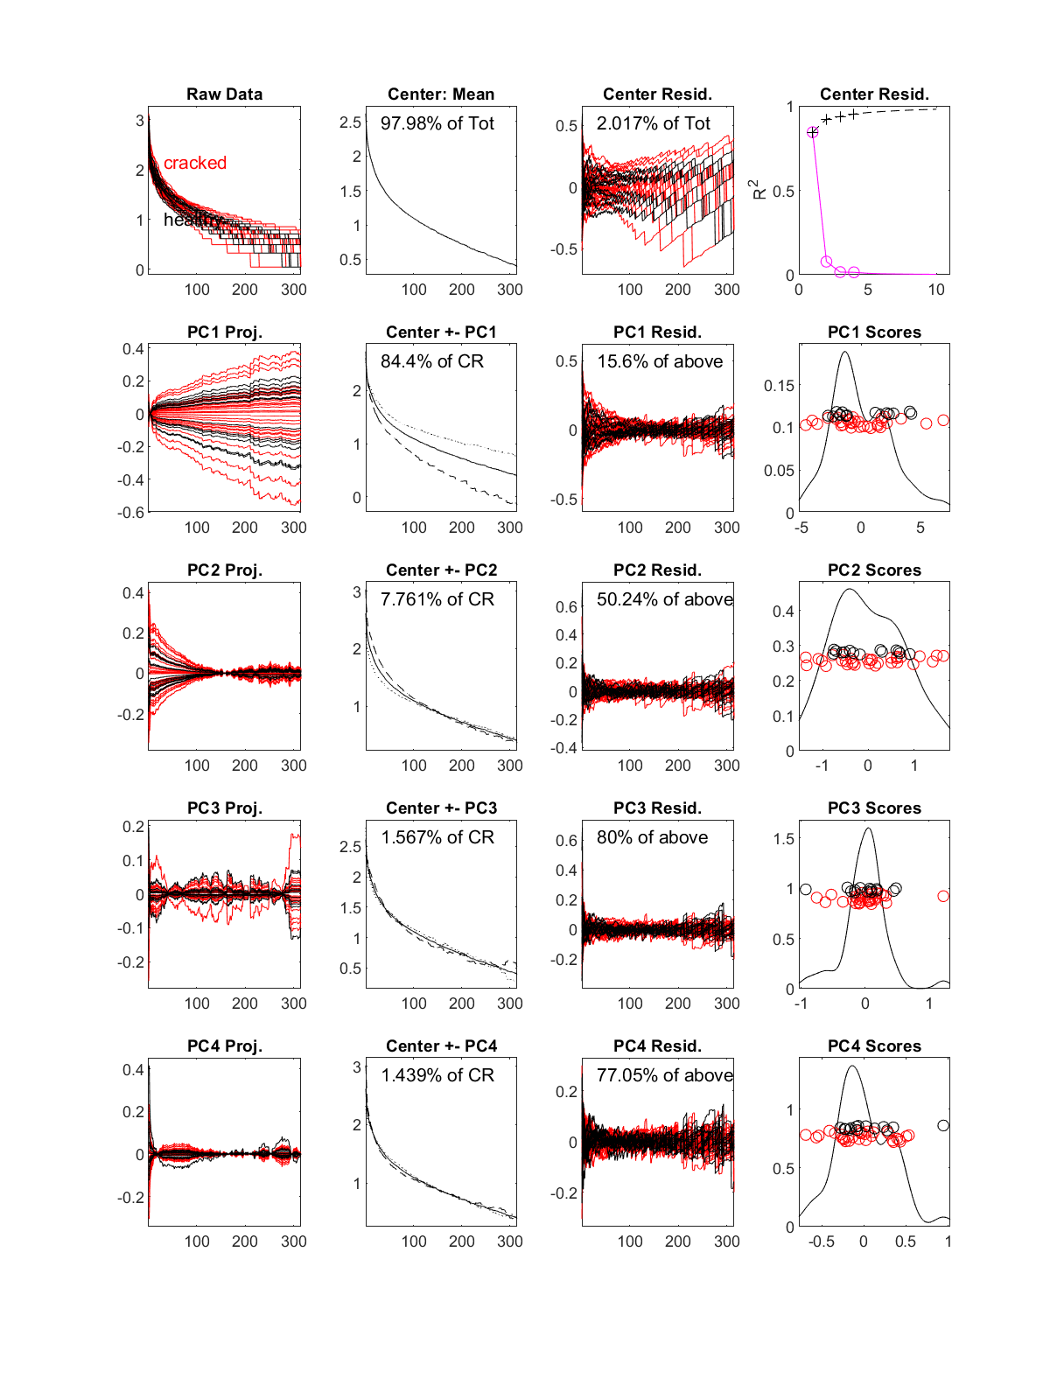
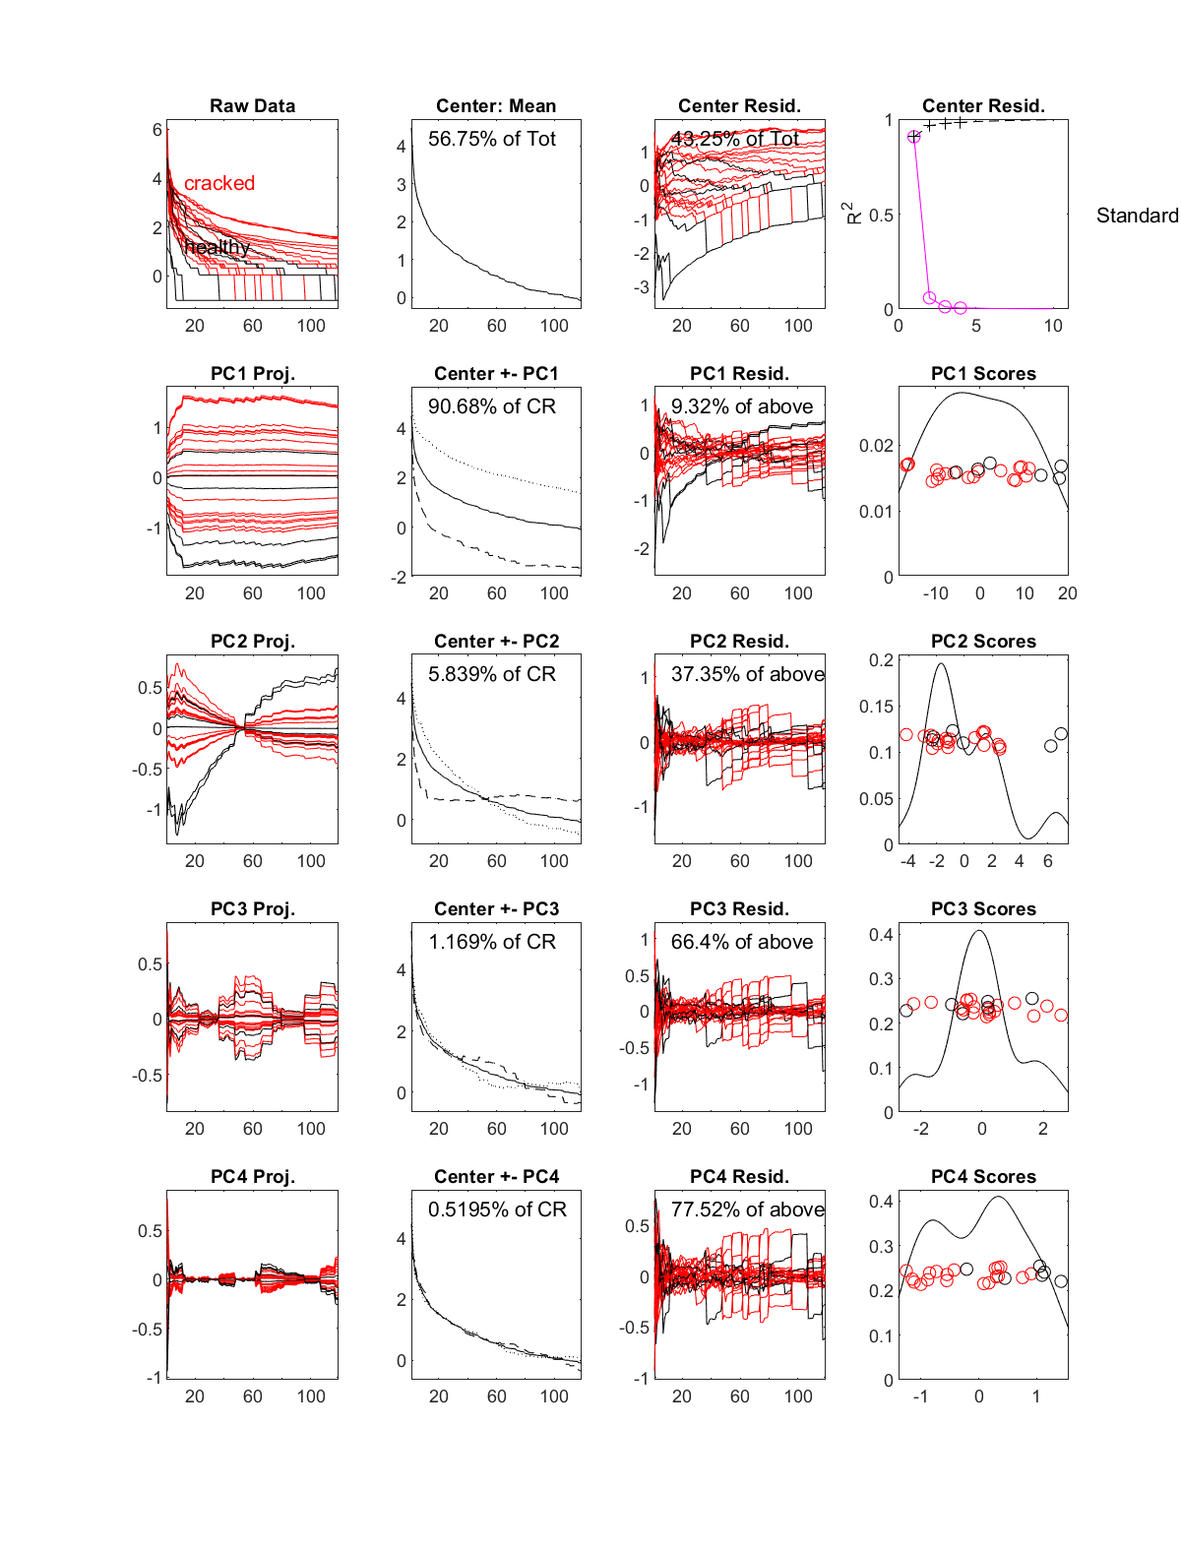
a
Micro-CT
b
Hr-CBCT
Log₁₀(data)
Log₁₀(data)

Slide 7
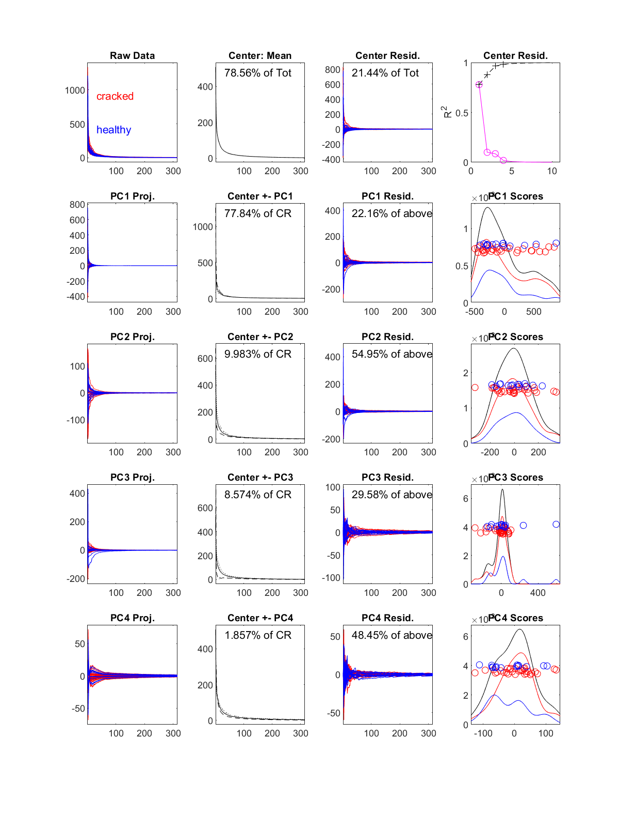
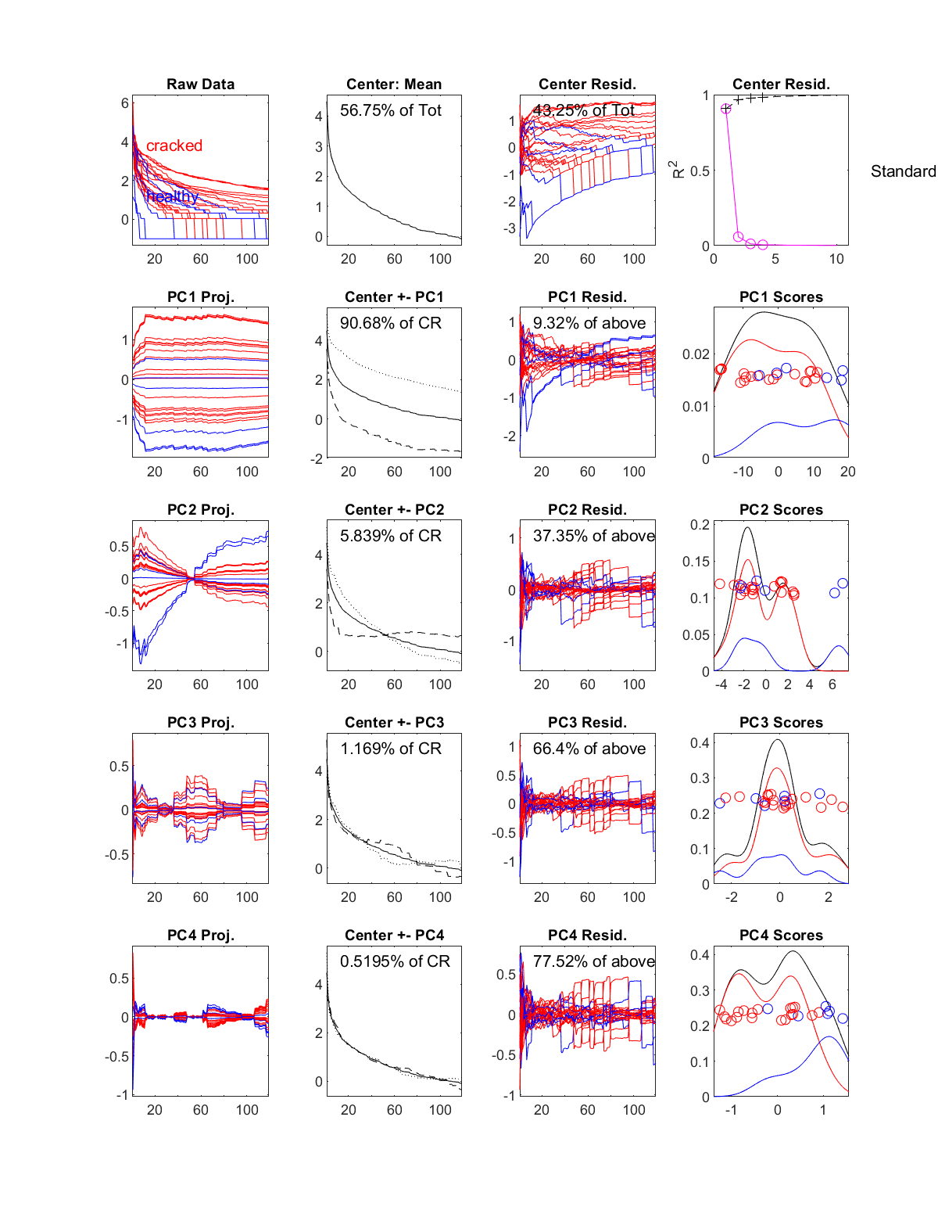
a
Micro-CT
b
Hr-CBCT
Log₁₀(data)
Log₁₀(data)

Slide 8
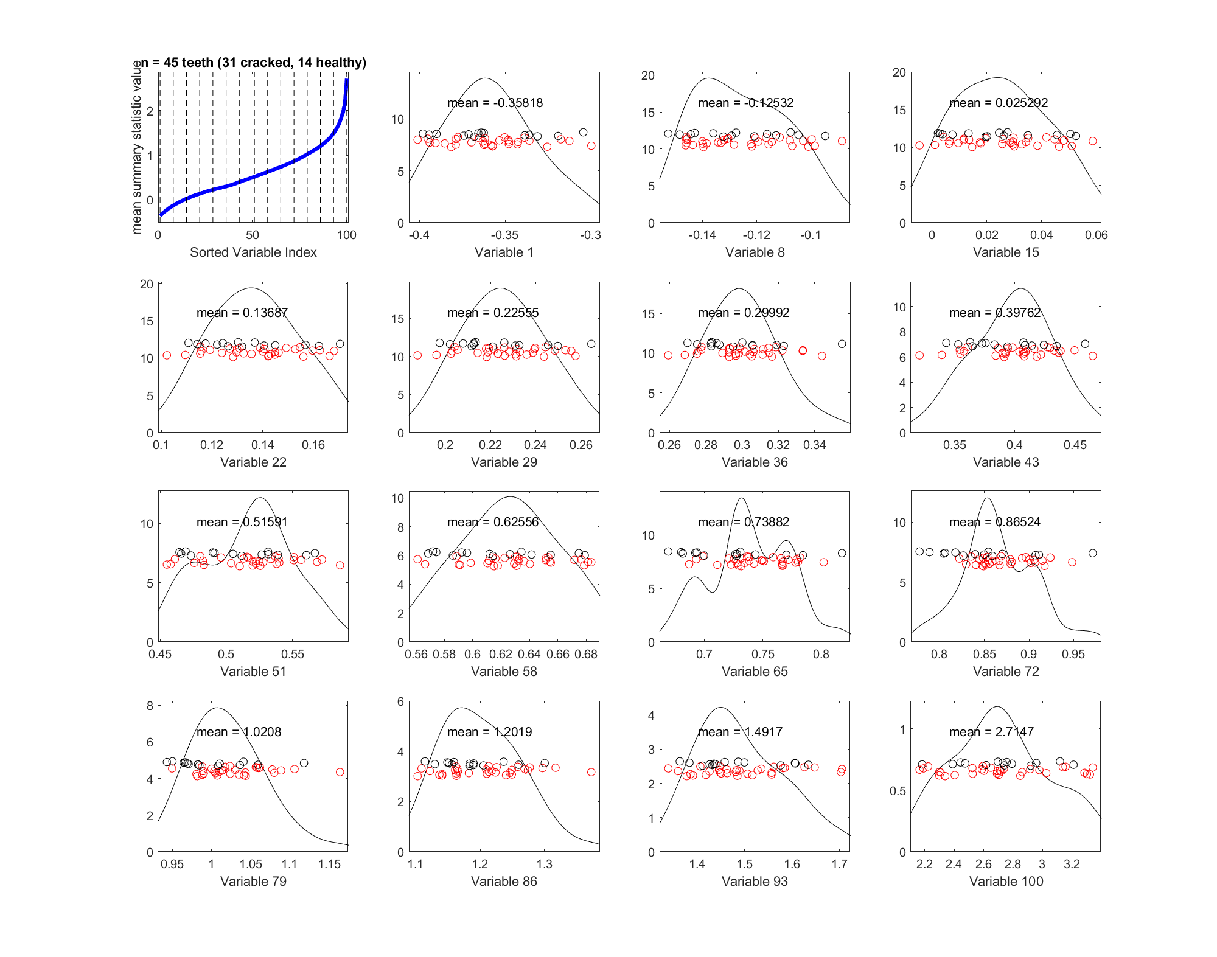
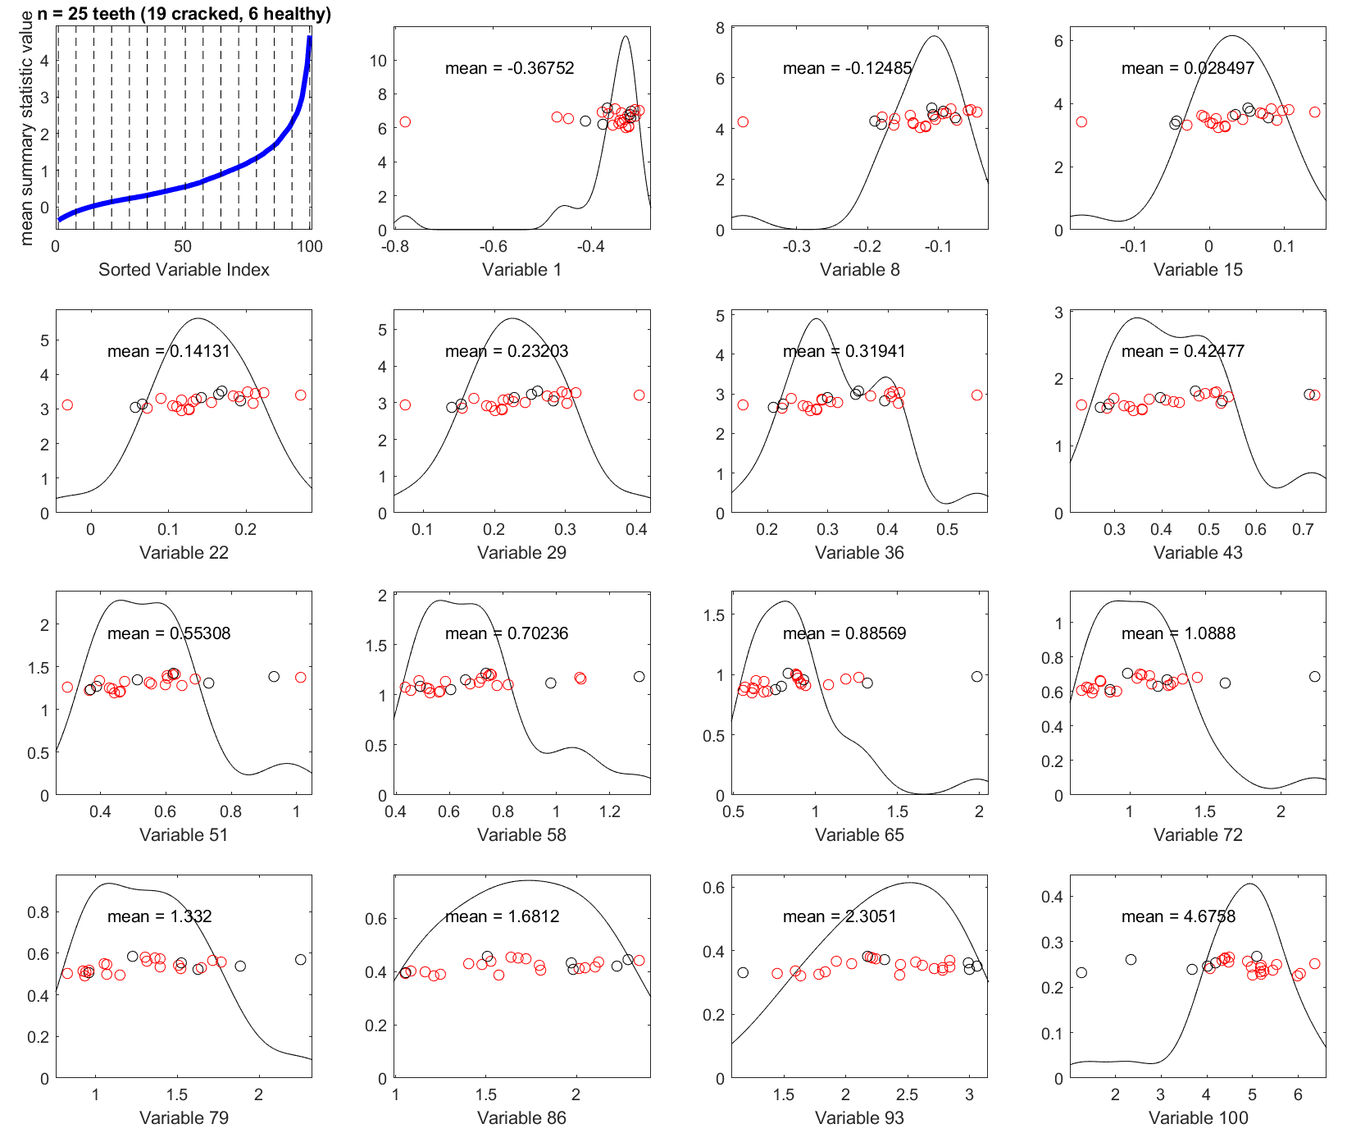
a
Micro-CT
b
Hr-CBCT

Slide 9
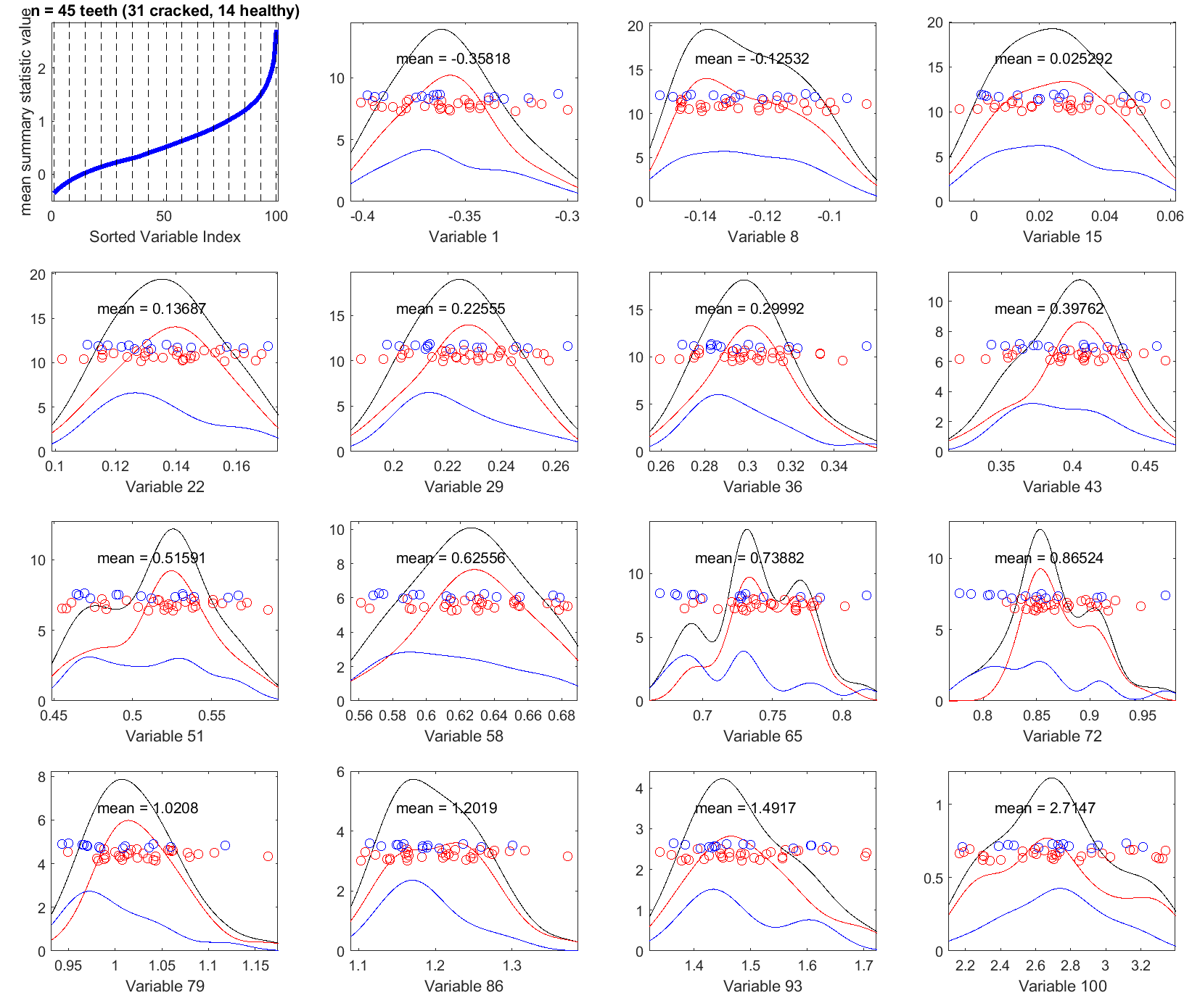
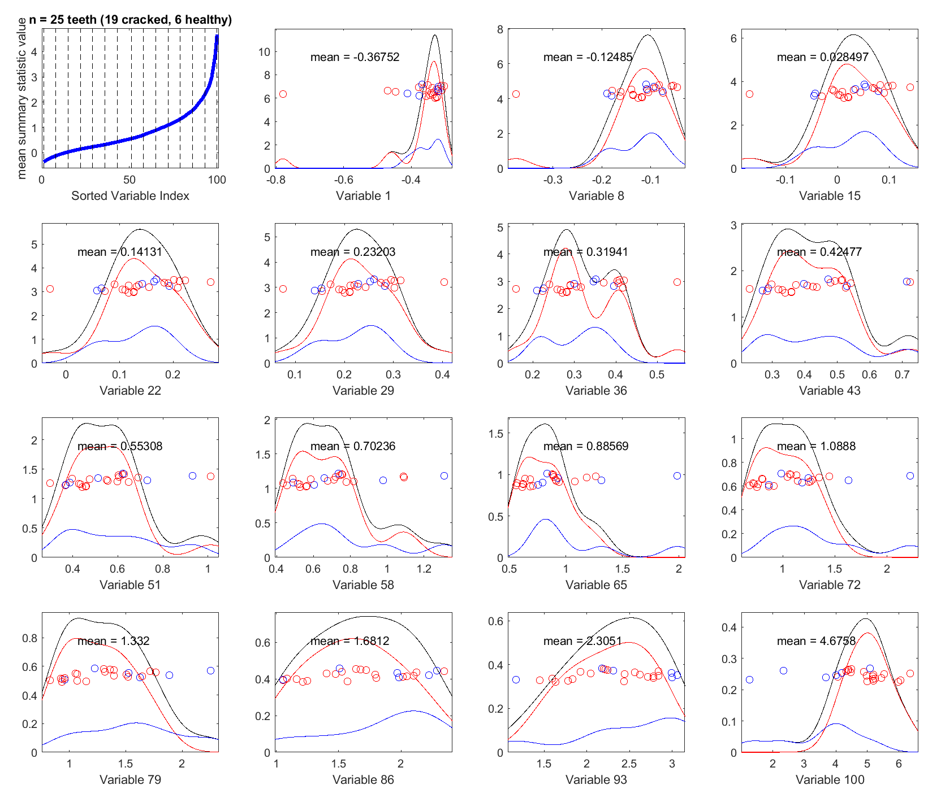
a
Micro-CT
b
Hr-CBCT

Slide 10
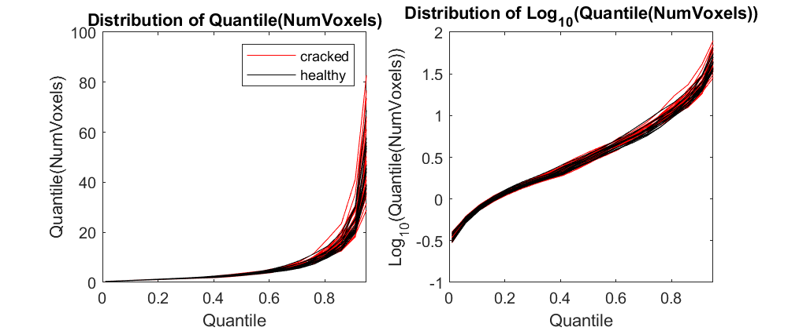
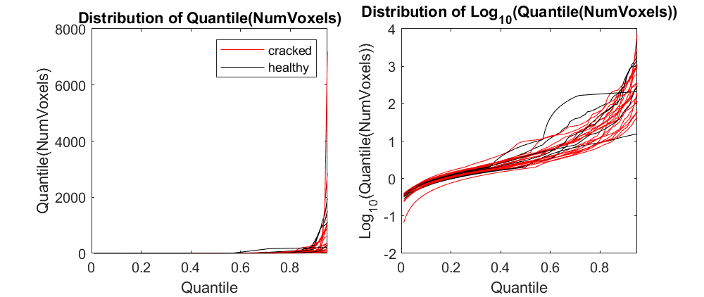
a
Micro-CT
b
Hr-CBCT

Slide 11
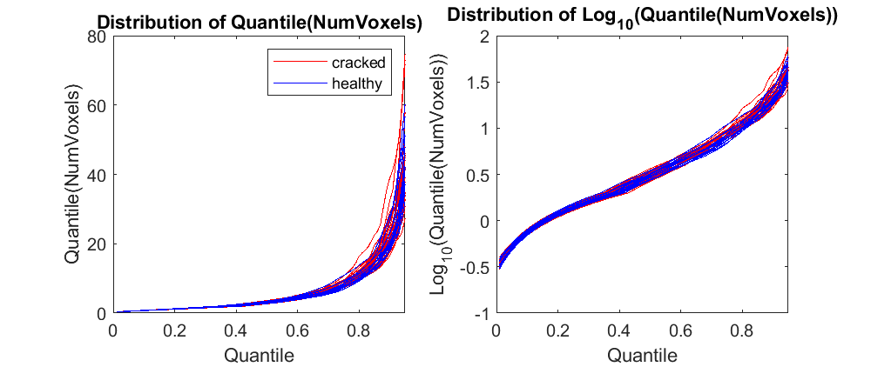
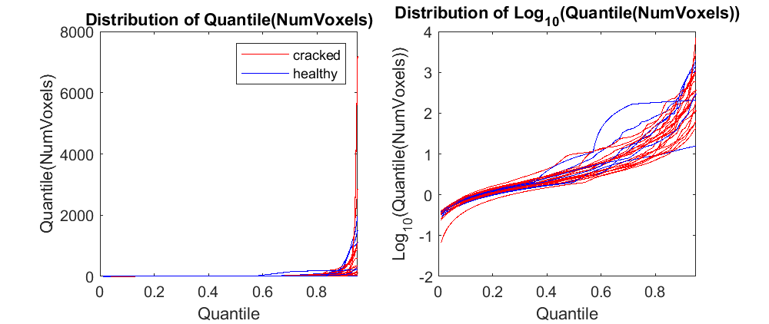
a
Micro-CT
b
Hr-CBCT
Crack Size Quantiles
Crack Size Quantiles
Quantile Value
Quantile Value
Log₁₀(Crack Size) Quantiles
Log₁₀(Crack Size) Quantiles
Quantile Value
Quantile Value

Slide 12
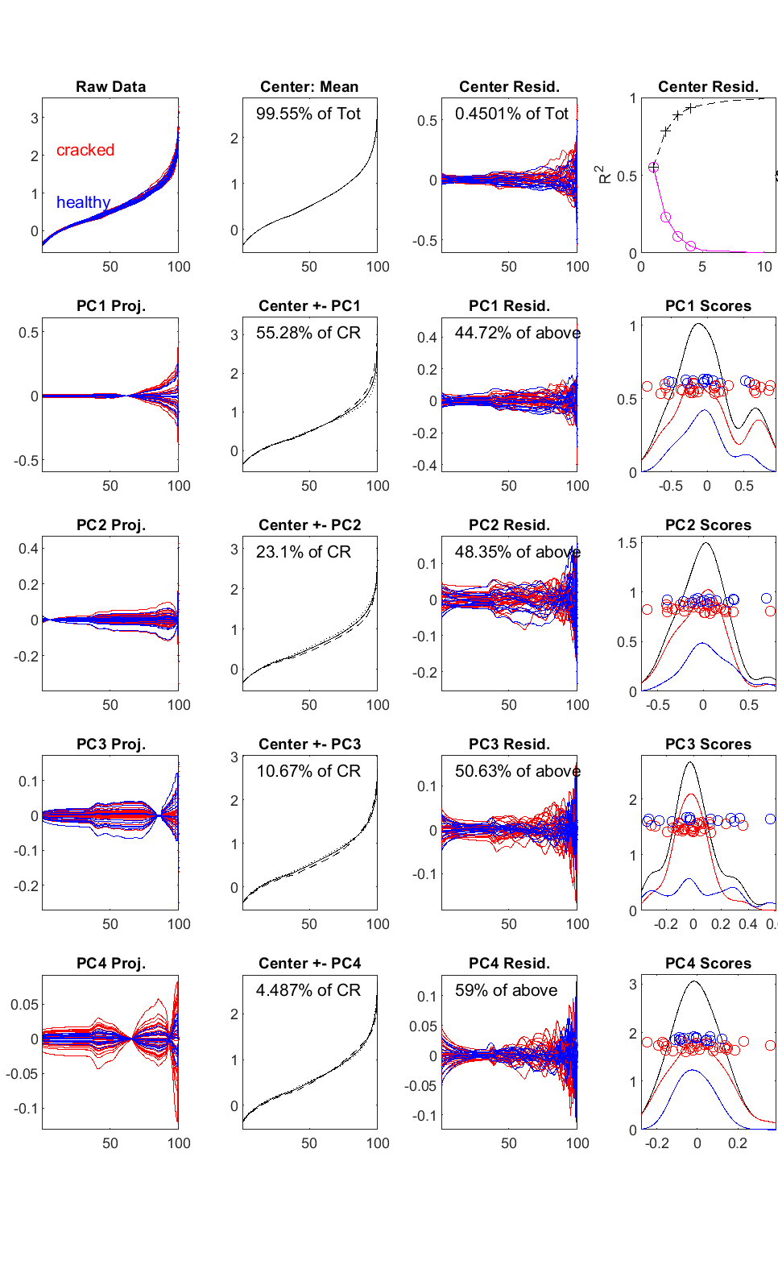
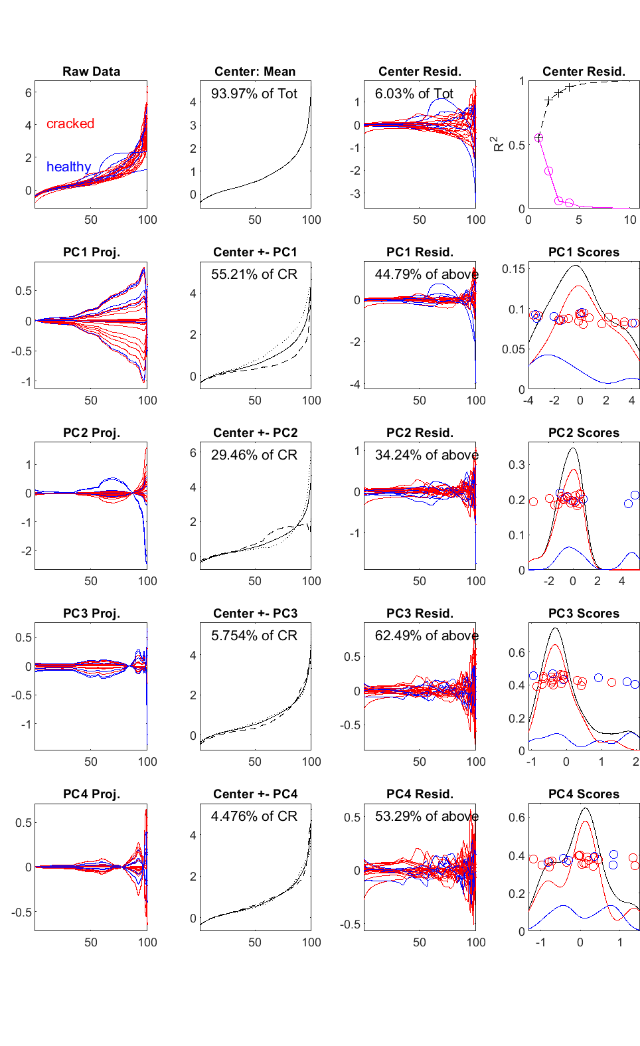
a
Micro-CT
b
Hr-CBCT
Log₁₀(quantile)
Log₁₀(quantile)

Slide 13
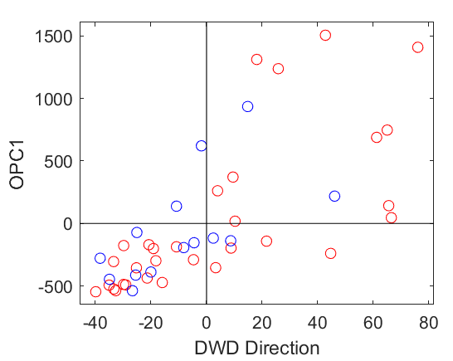
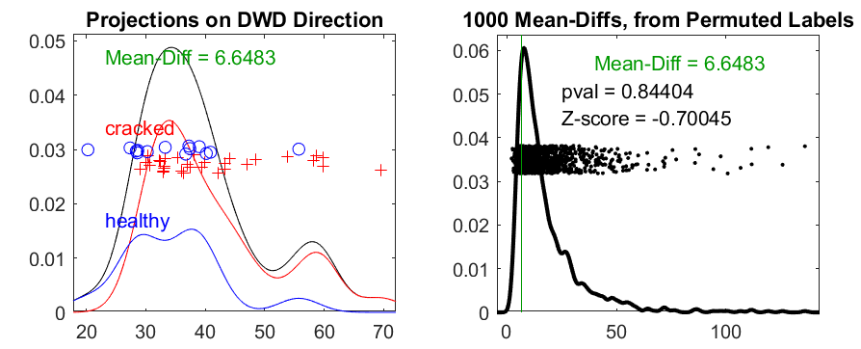
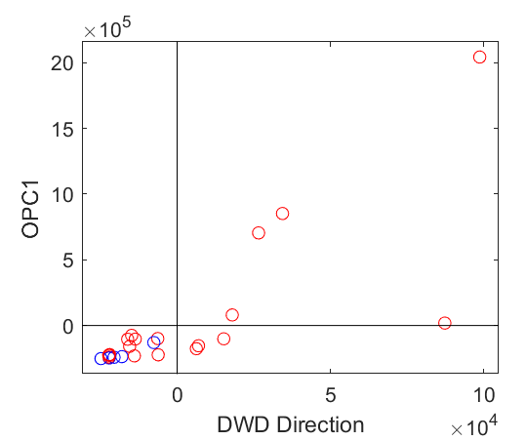
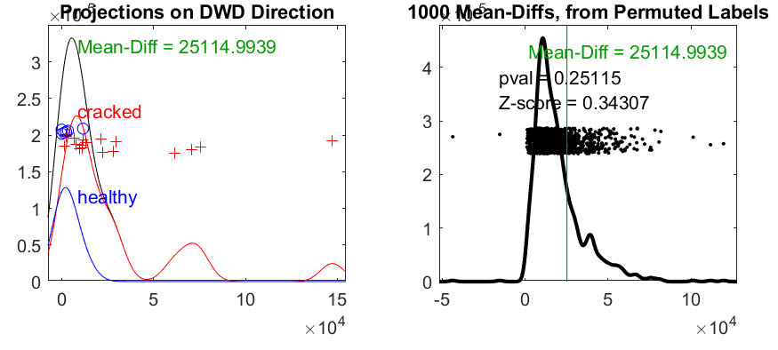
a
b
DWD classification for micro-CT
c
d
DWD classification for hr-CBCT

